Slide 1
MRS - TO Kick Off
SFDC #232976
Jul-2026

Slide 2
MRS TO PTC-IF Overview
Agenda:
MRS TO Overview
MRS Locomotives
MRS Trains
MRS Track
MRS PTC Architecture
MRS TO PTC-IF Architecture
TO Enablement Strategy

Slide 3
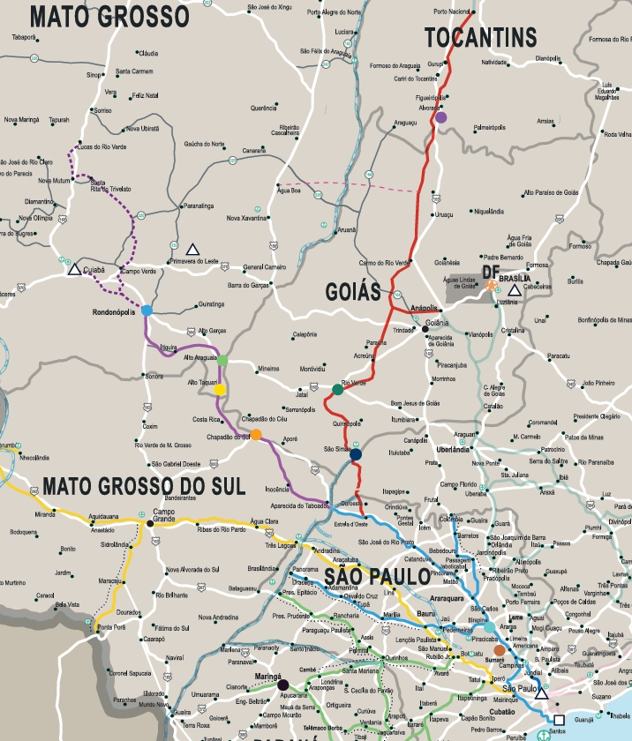
MRS TO Overview
Diversification and Growth: Besides its main focus on iron ore service application, MRS also operates on RUMO track (Malha Paulista) for the general cargo flow service (grains with soybeans/corn).
Fleet: In this segment, MRS operates a captive fleet of 51 AC44i at RUMO network equipped with PTC OBC, in addition to ~20 AC44i (w/o) PTC OBC (which might not be fully captive).
Trip Optimizer: This presentation provides an overview of MRS operations and the path to enable Trip Optimizer (TO) into such operations.

Slide 4

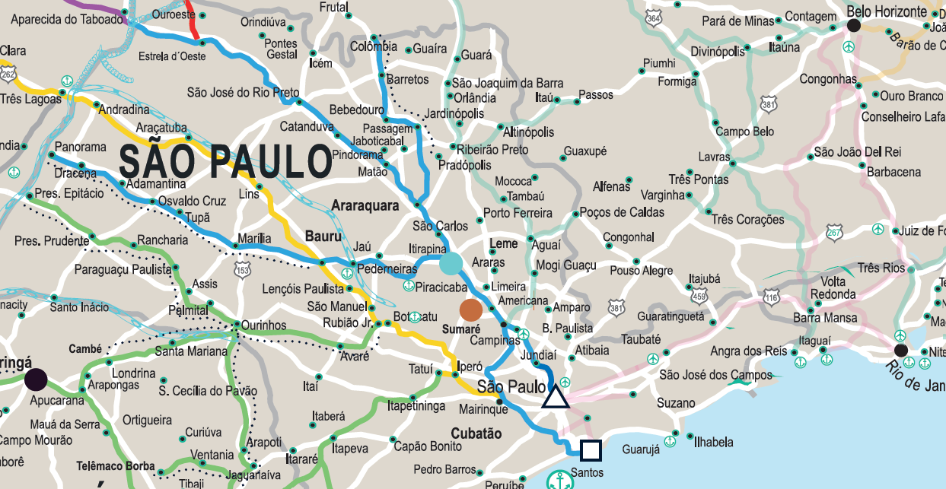
Sao Paulo Rail Map

Slide 5


Commercial Strategy... Why TO for Sao Paulo Ops?
Customer Ask
Wabtec Strategy
Train Handling
Operations standardization among different trains and operators (in-train forces more restricted than AAR)
Growing for new segments at Rumo’s tracks...
Fuel Saving
Enabler for tangible NPV savings
Roadmap to Automation
Mid-Long plans for unmanned/ remote operations (preliminary focus on iron ore service)
Offer Trip Optimizer solution (including hardware & software) to earn credibility back on this discussion with MRS (after heavy haul service ‘bitter’ experiences)
Offer alternative pricing options (out of USA & Brazil supply)
Include SMA adding value with: optimize TO utilization rate, local technical assistance, rail network upadates (trackdatabase), SW bug fixes (equivalent to Rumo’s offering)
Include fuel savings commitment based on opportunities for higher efficiencies
Offer TO Z2Z functionality as phased approach

Slide 6
2016 Contractual Scope
Customized solution for Trip Optimizer software at MRS segment (Heavy Haul/ Iron Ore Service)
Full integration w CBTC keeping MRS accountable for ICD availability for integration
Hold MRS safety standards
Compatibility w/ 134 & 268 rail car trains (as well potential changes on train configuration)
> = 2,65% fuel saving at 134 rail car train
69 HW and SW licenses @ $87,000/ unit ExW Erie, US, subject to proven fuel savings
Technical support, training for train operators
10 years SW bug fixes for systemic failures
12 months warranty

Slide 7
Lessons Learned from 2016 Contract
Installed Base/ Assessment
Management
Underestimated MRS in-train forces being more restricted than AAR...software changes
Underestimated comm loss inside tunnels
Underestimated AC44i Locomotive hasn’t exactly the same configuration between MRS & USA Fleet
Underestimated CBTC with TO Integration (GE & Wabtec as 2 separate companies)
No achievement on fuel savings: Underestimated MRS expertise on heavy haul service and their discipline for improving YoY their optimized operations
GE Engineering resources limitation with 3 TO projects signed at the same time (MRS, Vale & Rumo)

Slide 8
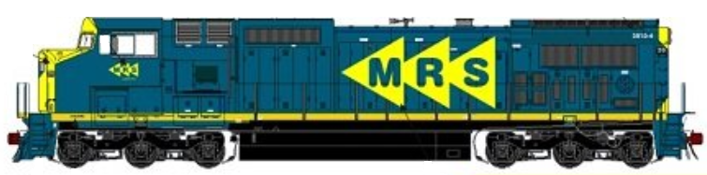
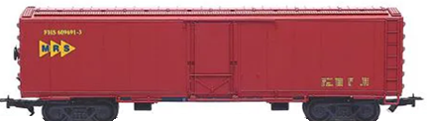
MRS Locomotive Configuration
AC44i (or ES44) Locomotives:
  AC propulsion.
  6 axles CC.
  Wide gauge.
  Traction Power – 4400 THP.
  STE/CTE – 200k lbf / 166k lbf.
  CCA control architecture
  These locomotives are very similar to the ES44AC locomotives, except they use 7FDL-LC diesel engines instead of the EVO engine.
  Trip Init with PTC-Wabtec
In the past few years (2018/2019) MRS ran a pilot with 4 Locomotives with TO installed for iron ore application. No tests were ever performed at MRS general cargo flow service (Rumo’s tracks).
Status of the Trip Optimizer installation is unknown.
  TO has been disabled for several years
TO software used in MRS in 2018/2019
  CCA = 55.36.20
  CCA Configs = various (all released)
  TO Package = 37.03.05.01.204031 (i.e., 20.40.31)
  EM Configs = EM000051, EM000052
  HPEAP: RMD_APP_0421_560A.tgz
Loco 7331 and 7314 are already operating in RUMO tracks

Slide 9


MRS’s Train Information
Train Type: Loaded and Empty Grain
Car Type: Hopper Covered
Locomotives: AC44 or ES44
Train Consist
# Cars | Loco Position | DTM | Loaded Weight (Metric Ton) | Length (m) | Total Car Axles | Similarities with RUMO over 1 year
84 | (1x27x1x57x1) | N | 10920 | 1530 | 336 | 0.4%
120 | (2x40x1x80x1) | N | 15600 | 2250 | 480 | 3.1%
135 | (2x43x1x92x1) | N | 17200 | 2400 | 540 | 5.2%
135 | (2x42x1x42x1x51) | N | 17200 | 2400 | 540 | Included in the 5.2% above
Leader
27 Cars
DP1
57 Cars
DP2
Train Consist Schema for 84 cars

Slide 10


MRS’s Simple Track
ZVP – Votuporanga
Crew Change Point
KMP 301
ZZM – Simonsen
Crew Change Point
KMP 290
ZRU – Rio Preto Paulista
Crew Change Point
KMP 202
KMP 257 ← → KMP 156
MRS’s Crew Change Point
Origin | Origin ID | Destination | Destination ID
Pereque | ZPG | Votuporanga | ZVP
Itirapina | ZIQ | Pederneiras | ZPD
Tutoia | ZTO | Pradopólis | ZXE
RUMO’s Crew Change Point
6
RUMO’s Region Boundary
ZXE – Pradópolis
Crew Chage Point
KMP 320+591
ZGA – GUAIANÃ /ZKE – Canguera
Lomotive Helper Station
Rail Road KMP Change
KMP 147 - KMP 76
ZSD – Santa Adélia
Crew Chage Point
KMP 114
ZIQ – Itirapina
Crew Chage Point
KMP 169
ZRX – Rio Claro Novo
Crew Change Point
KMP 130
ZBV – Boa Vista Velha
Rail Road KMP Change
KMP 50 – KMP 253
ZYU – Itú
Crew Change Point
KMP 201
ZEM – Embu-Guaçu
Crew Change Point
KMP 133
11
ZKW – Caucaia
KMP 98
5
ZTO – Tutoia/Araraquara
Crew Change Point
Rail Road KMP Change
KMP 0 – KMP 253
4
3
2
10
Helper Zone
TO is currently not active on Sections 10 and 11
  Section 1 – Serra de Santos
  Section 2 – Embu-Guacu
  Section 3 – Itu
  Section 4 – Campinas
  Section 5 – Araraquara
  Section 6 – Rio Preto
  Section 10 – Bauru Branch
  Section 11 - Araraquara a Colombia Branch
ZPD – Pederneiras
Crew Chage Point
KMP 301
ZXW – Pai Matias
Optional Crew Change Point
KMP 83
ZPT – Paratinga
Crew Change Point
KMP 106
KMP 128 ← → KMP 106
ZPG – Perequê
End of RUMO Road
KMP 124
KMP 134 ← → KMP 124
PORT OF SANTOS
Start Mountain Grade
KMP 71
1
MRS RAILROAD TO ACCESS PORT OF SANTOS
(LEFT MARGIN)
July 17, 2026

Slide 11
Current PTC Proposed Architecture (Interoperability)

Slide 12
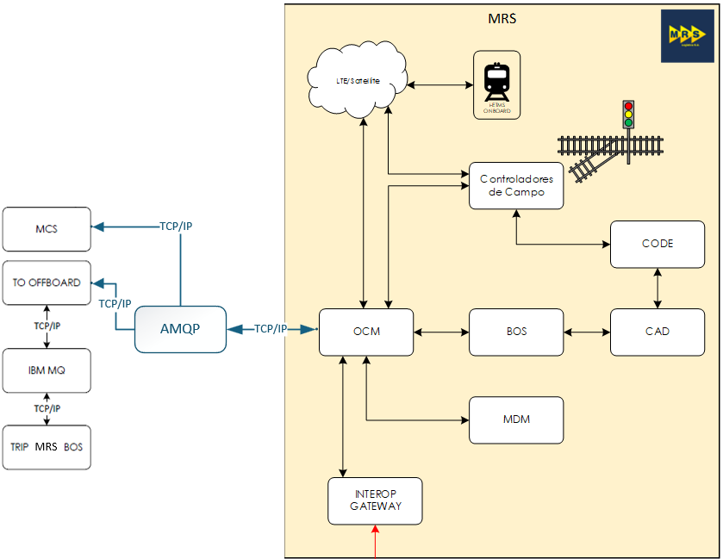
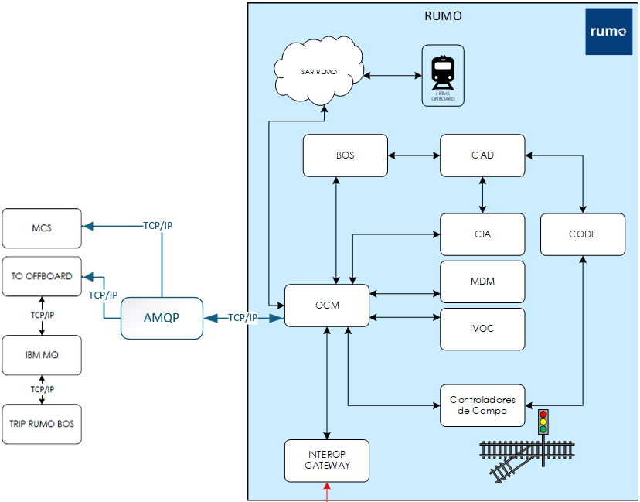
TO Proposed Architecture
New
Same as RUMO
TO Offboard for MRS already exists

Slide 13
MRS PTC-IF Interoperable Operation Proposal
3 Step approach
Step 1: Initial Simulation
Wabtec simulates operating conditions (no field visit required).
Objective: First view of in-train forces for 135-car trains.
Trigger: Agreement on in-train forces metric for Paulista Network.
Note: MRS is looking for values below 100 Kips, but not necessarily the same thresholds of the iron ore loop.
Step 2: Preparation for Qualification Test
Define boundary conditions for the project on MRS trains.
Develop document and methodology for the test.
Evaluate and adapt locomotives for the test.
Trigger: Methodology document approved + locomotives ready with Trip Optimizer active.
Note: Wabtec will effectively release the finalized software for MRS. Once approved, SW will be deployed on all locos.
Step 3: Multi-Year Agreement
Continuous improvement and joint operation between MRS and Wabtec for all locomotives on the Paulista Network.
Ensure Wabtec support for all lead locomotives.
Prepare MRS for future expansions (territory, operational models, technologies).
Trigger: Qualification Test approved + commercial/technical conditions defined + agreement signed.
Owning RR: MRS
Employing RR: MRS
Operating RR: RUMO
Premises:
No additional feature needed (to be confirmed after simulations).
Need to re-enable TO on pilot locos (service work scope)
Need to review installation process for TO on a Card
PTC Protect is fully deployed and functional on MRS locos

Slide 14
Trip Optimizer Historical Pricing (2016–2026)
2016 Contract Pricing
Ex-Works USA
2026 Customer Price Simulation
Ex-Works USA
Simulated Contractual
Escalation
2016 Business Case:
Customer pay back based on 2.65% fuel savings over 1M liters burned per locomotive
Key Takeaway: Customer value perception is primarily concentrated on the License and Installation Kit components.

Slide 16
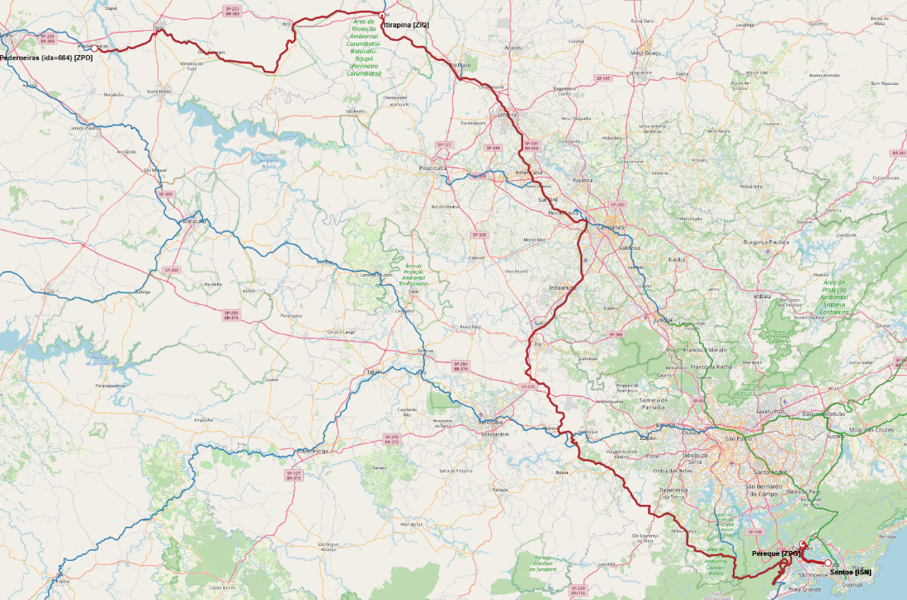
Distâncias Ferroviárias
Pederneiras a Itirapina = 138.1 km
Itirapina até Pereque = 397.8 km
Perequê até Santos = 17.6 km
Total = 553,5 km
Notes:
Pederneiras a Itirapina que é o trecho que a gente falou sobre a separacao do teste do TO é 138.1 km , de itirapina até pereque sao 397.8 km, e de pereque até o porto de santos sao 17.6 km

